Slide 1
Pteropods
# of records
# of species
# of redlist
Deep-water corals
Deep-sea hydrothermal vents
Deepest fish
# of species
What we do
Database
Portal
Mapper
Downloads
Training
Support scientists
Future
Environmental data
Tracking data
DNA
eDNA
Image/video data
Quality annotations
Text mining for new records
Citizen science
# of records

Slide 2
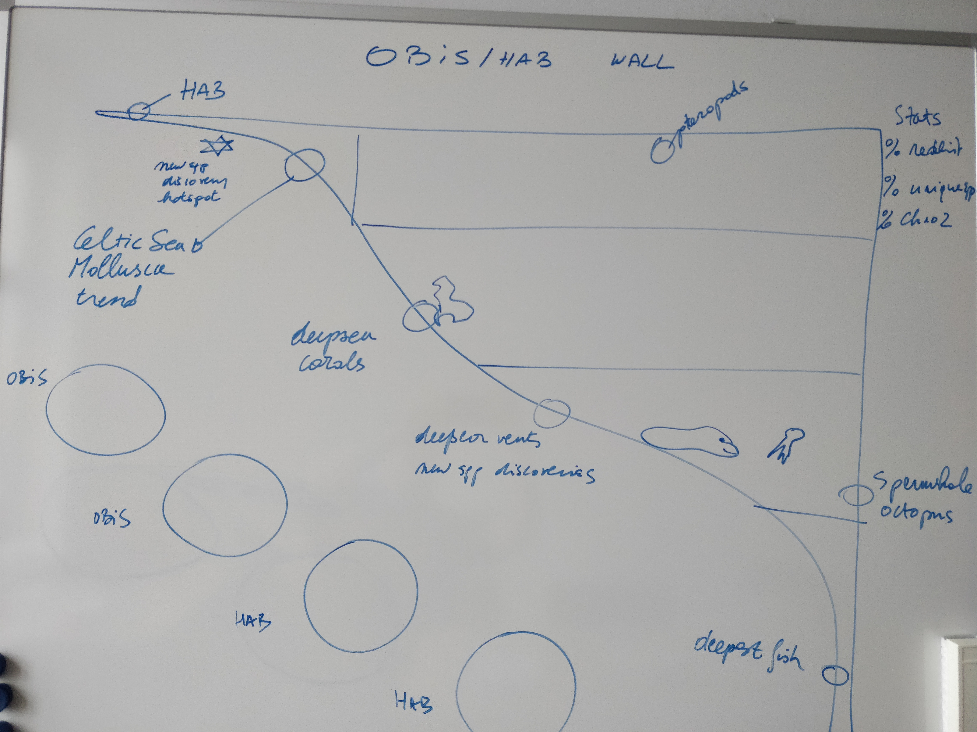

Slide 3
Nice quotes / Text ideas
The most commonly reported sources of species occurrence data were the Ocean Biogeographic Information System (OBIS) and Fish Base.
Freer, Jennifer J., et al. "Predicting ecological responses in a changing ocean: the effects of future climate uncertainty." Marine biology 165.1 (2018): 7.

Slide 4
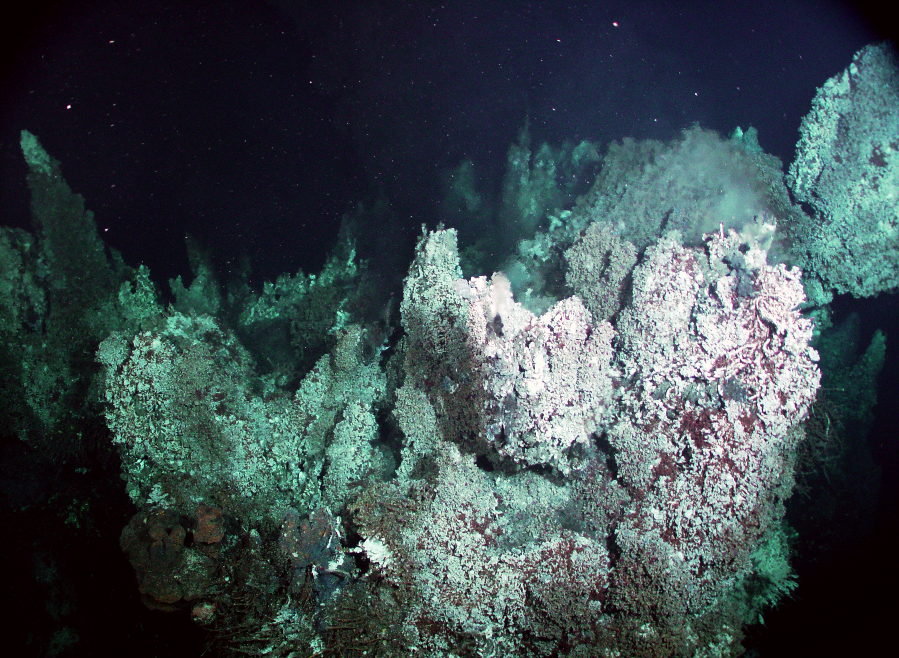
Storylines
Deepest fish
Deep-sea hydrothermal vents
Deep-water corals
Pteropods
Abyssobrotula galatheae Nielsen, 1977
Photo credit: Russ Hopcroft, UAF/NOAA
CC BY-NC
Photo credit: Smithsonian Institution, National Museum of Natural History,
Department of Vertebrate Zoology, Division of Fishes
CC BY-NC-SA
Pteropods – or sea butterflies – are tiny sea snails which play a critical role in various ocean ecosystems. Because of this critical role there is great concern about the potential impact of global change and particularly ocean acidification on these organisms. Changes in pteropod abundance could have strong impacts, as they play a critical role as a food source for fish, birds, whales and other zooplanktonic organisms.
Modeling. In order to model the impact of ocean acidification and global warming on pteropods, risk indicators have been calculated for major pteropod species.
Results. Under the pessimistic CO₂ emissions scenario, it is likely that by 2050 the chemical conditions of the water in most of the Arctic Ocean will limit the formation of pteropod shells, meaning they will not be able to thrive in most of the Arctic Ocean. The temperate water species will also very likely be affected by global change, with only 26% of the ocean representing low risk for them by 2050. Warm water species probably will not be as strongly affected by ocean acidification by 2050, but excessive temperatures will likely reduce their area of distribution, particularly in the equatorial Pacific.
http://onesharedocean.org/open_ocean/ecosystems/pteropods_at_risk
Abyssobrotula galatheae, is a species of cusk eel in the family Ophidiidae. It is one of the deepest living fish in the world. Though uncommon, this species is known from all tropical and subtropical oceans. It occurs below a depth of 3,110 m (10,200 ft) and is bottom-dwelling in nature. Its diet consists of polychaete worms and crustaceans, such as isopods and amphipods.
Photo credit: Ocean Networks Canada
CC BY-NC-SA
Photo credit: Nick Hobgood
CC BY-NC-SA
Deep-sea Hydrothermal vents are typically formed along the mid-ocean ridges where two tectonic plates are diverging. Despite the lack of sunlight and the presence of exterme temperatures, high pressure and toxic minerals, hydrothermal vents have a density of organisms 10,000 to 100,000 times greater than the surrounding sea floor. This is made possible by bacteria which transform these minerals by chemosynthesis into organic material, providing food for other vent organisms. Since the first of discovery of deep-sea hydrothermal vents along the Galápagos Rift in 1977, numerous vent sites have been found and more then 400 new species and unusual have been discovered in this extreme environments. One of these, the Pomeii worm (Alvinella pompejana) is capable of withstanding temperatures up to 80°C. While the scaly-foot gastropod Chrysomallon squamiferum uses iron sulfides (pyrite and greigite) for the structure of its dermal sclerites (hardened body parts), instead of calcium carbonate.
Example dataset: http://iobis.org/explore/#/dataset/3905
Photo credit: NOAA
Public domain
Deep-water corals, also known as cold-water corals, occur at deeper, darker and colder parts of the oceans than tropical corals. They are most often stony corals and, like tropical corals, they provide essential habitat for other species. There are nearly as many deep-water corals as shallow-water species but only few deep-water species develop traditional reefs.
Example dataset: http://iobis.org/explore/#/dataset/265

